Slide 1
Debugging and Monitoring while using IBM Cloud Private

Slide 2
Agenda
Monitoring
Logging
Debugging
CLI tools
Resources for next steps

Slide 3
Monitoring

Slide 4
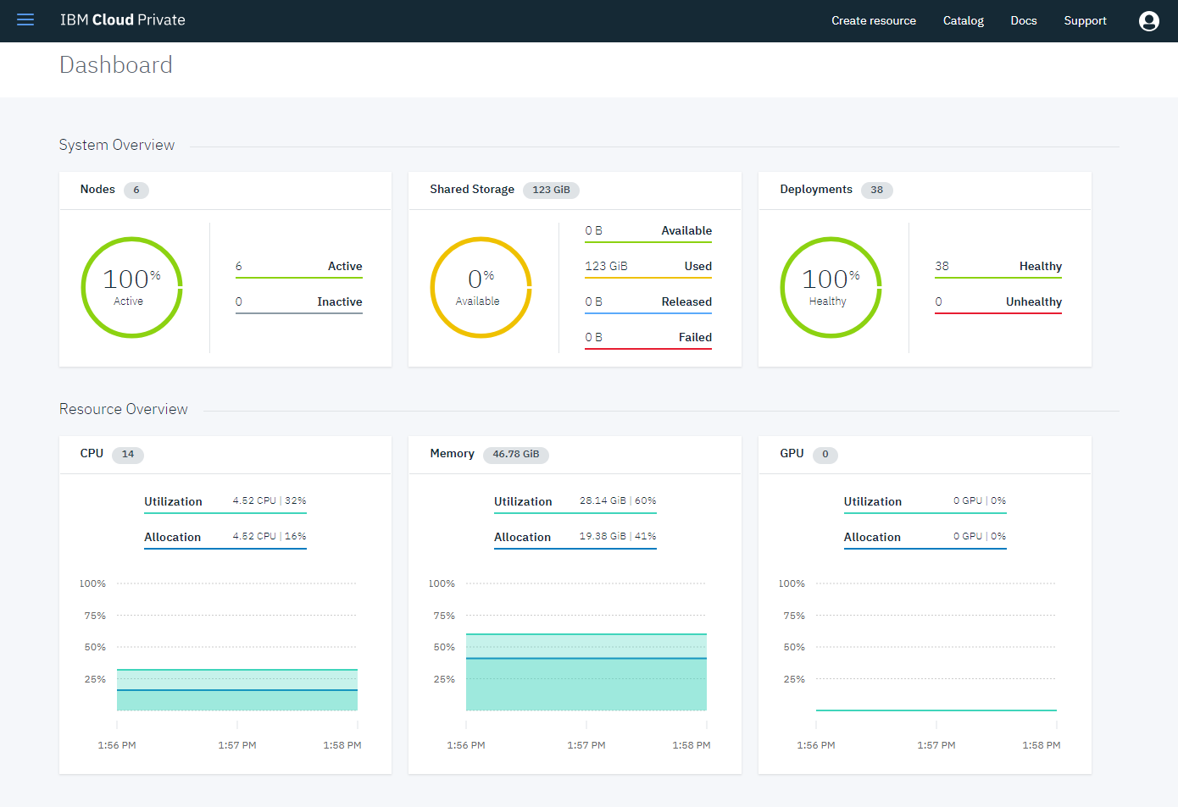
Default dashboard in IBM Cloud Private
System Overview
Nodes
Shared Storage
Deployments
Resource Overview
CPU
Memory
GPU

Slide 5
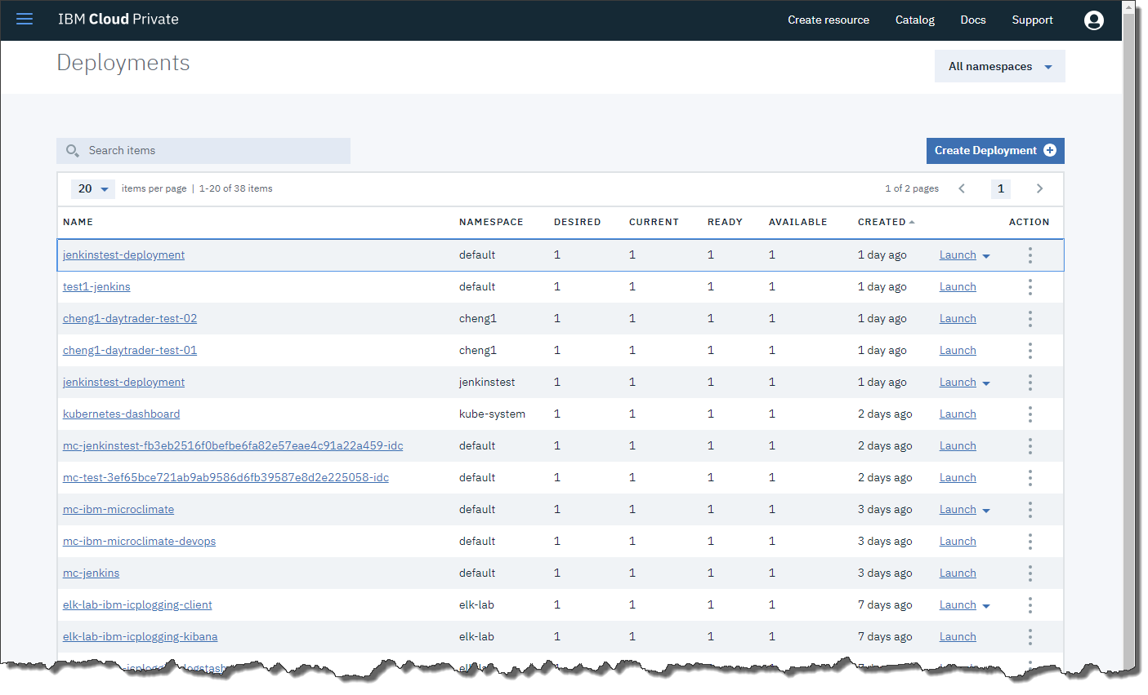
Workload dashboard in IBM Cloud Private
Workload – Deployments
Status of deployments is available to help understand current the number of instances as compared to the desired. Four states are reported:
Desired
Current
Ready
Available

Slide 6

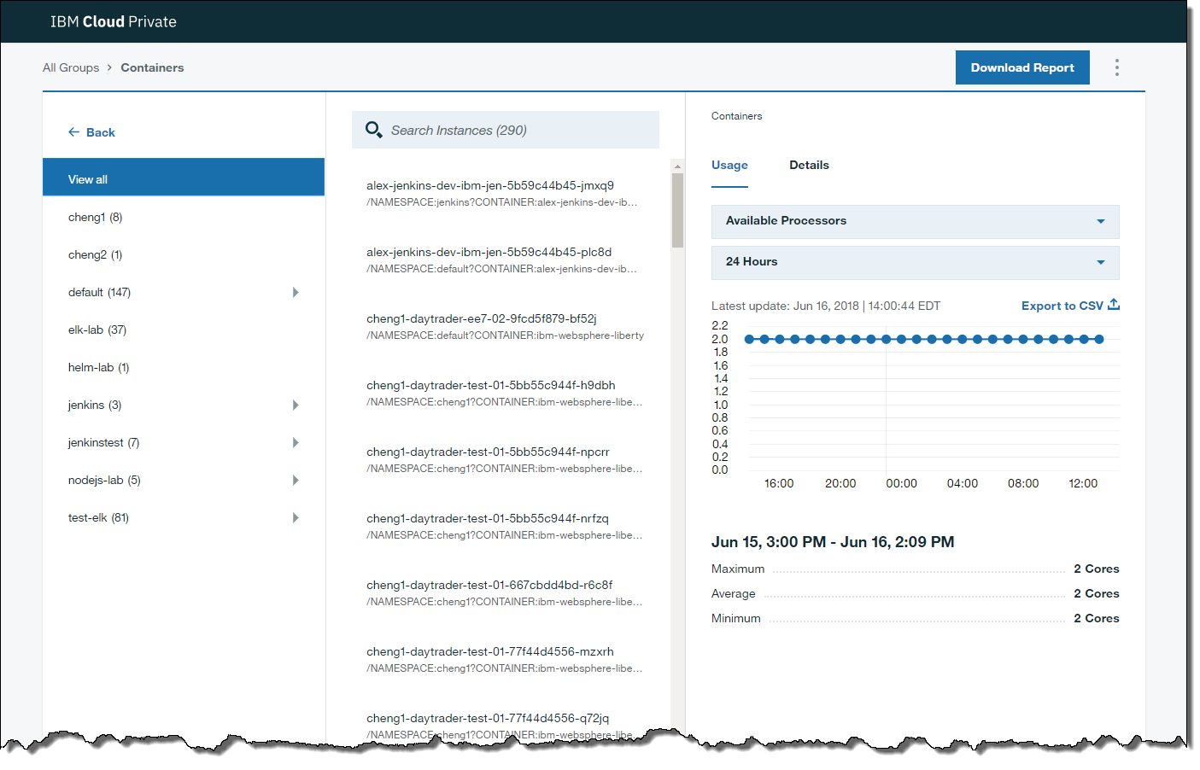
Metering dashboard in IBM Cloud Private
The metering service is automatically installed as part of the IBM Cloud Private environment.
Use the metering service to view and download detailed usage metrics for applications and cluster.

Slide 7
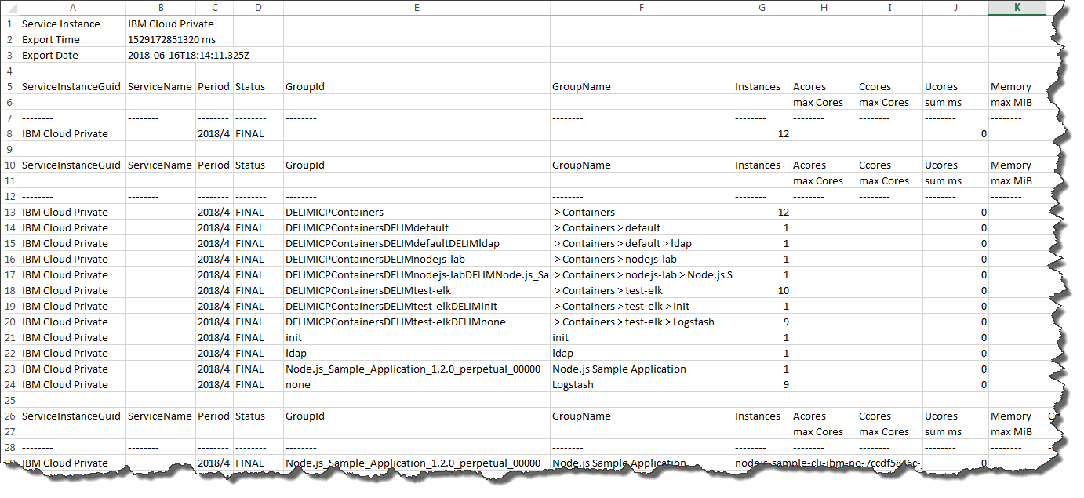
Metering – export data to spread sheet
Use the metering service to view and download detailed usage metrics for applications and cluster.
https://www.ibm.com/support/knowledgecenter/en/SSBS6K_2.1.0.3/manage_metrics/metering_service.html
https://<masterNode>:8443/metering/secure/c2c/reporter

Slide 8
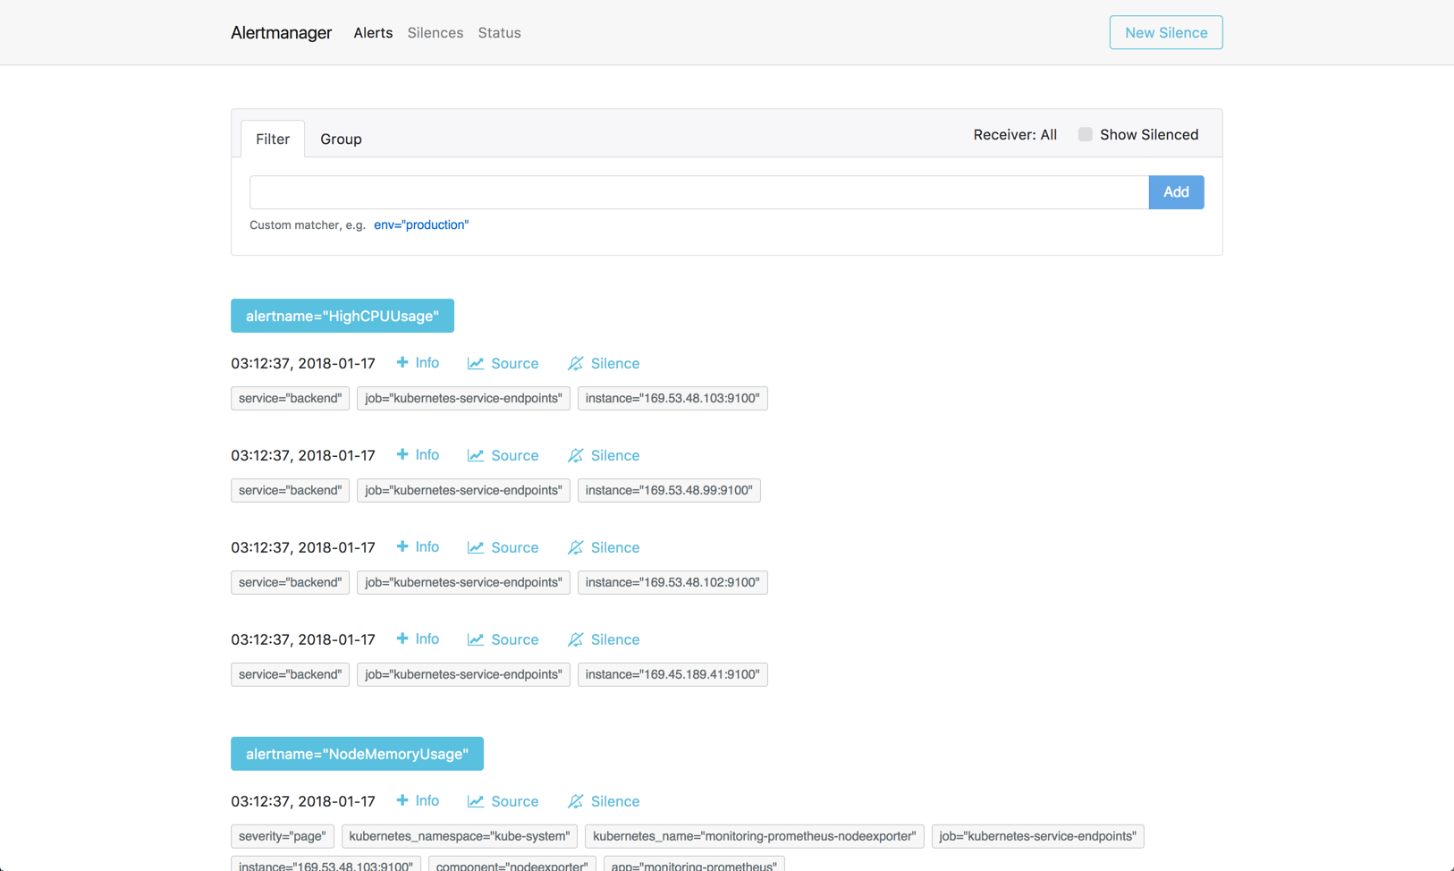
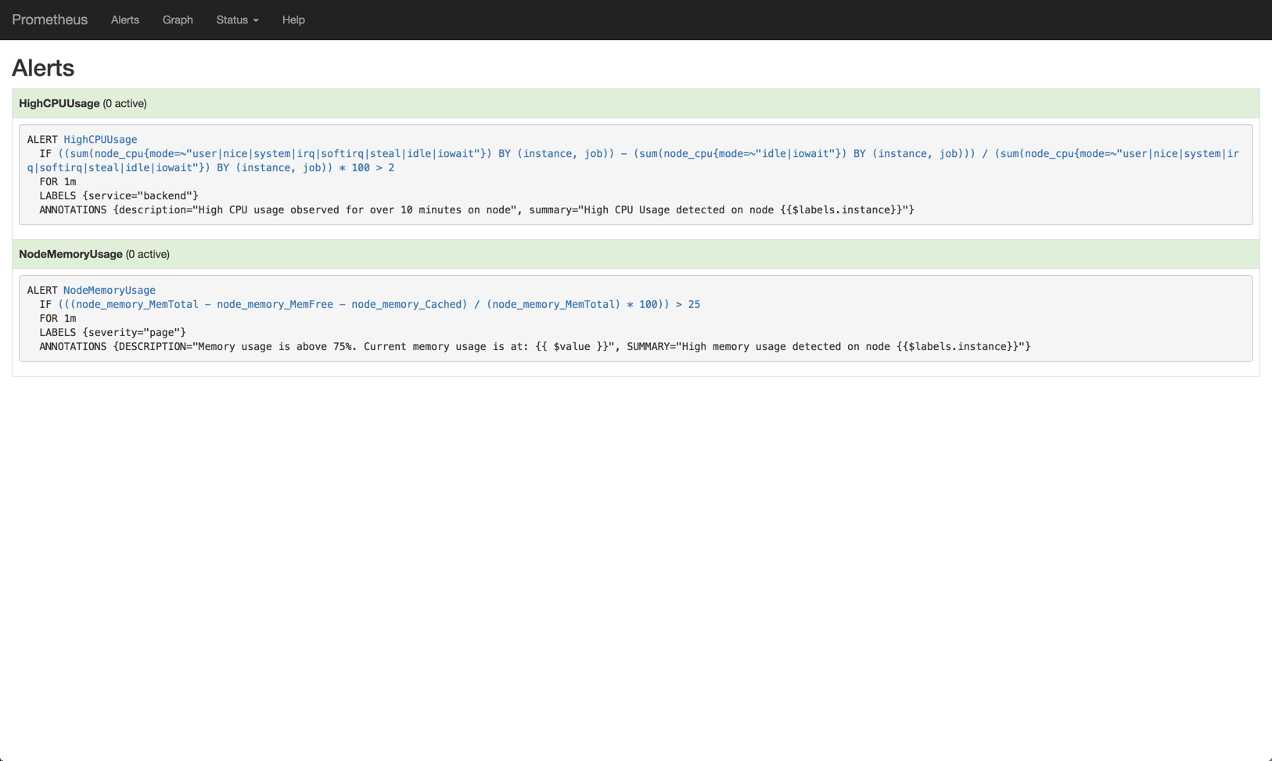
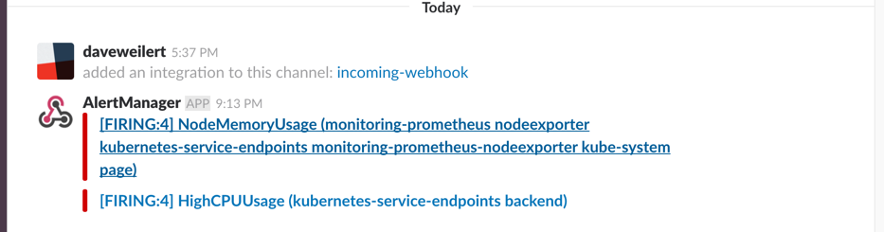
Alerts
Configure Prometheus alerts to provide timely information.
These alerts can be integrated with external alert service providers, such as Slack or PagerDuty for IBM Cloud Private.
IBM Cloud Private
Alertmanager
Slack Alert
Prometheus
console

Slide 9
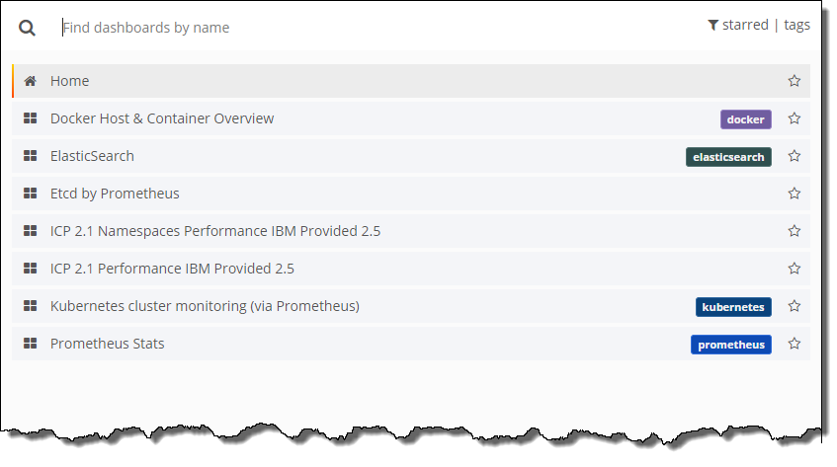
Available Grafana dashboards in IBM Cloud Private
These seven dashboards enable viewing of information in the following categories:
Docker
ElasticSearch
etcd
Kubernetes
Prometheus
ICP
Note: IBM Cloud requires deploying Monitor service. Above screen is from IBM Cloud Private.

Slide 10
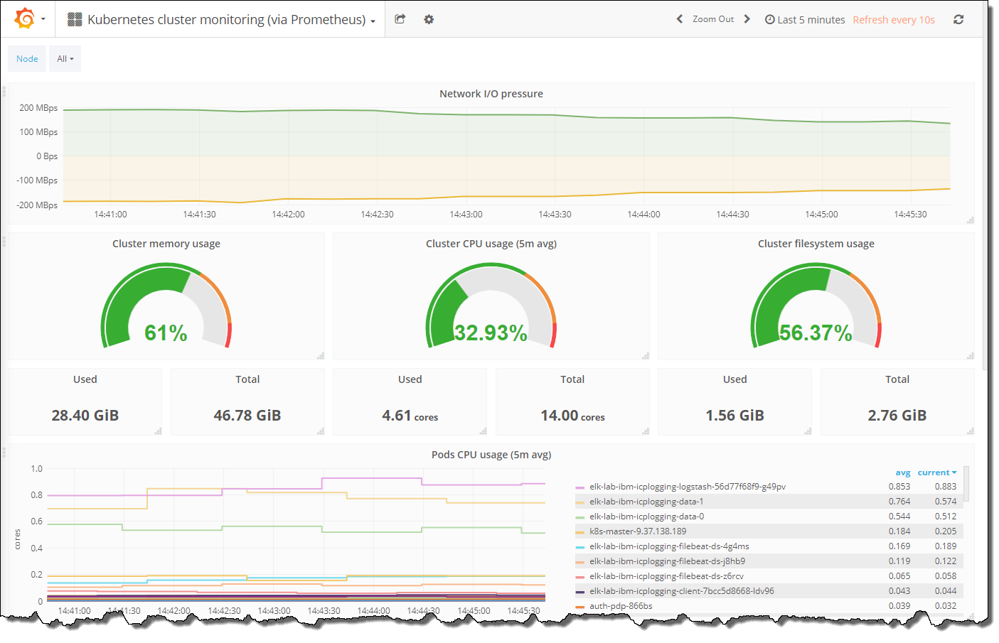
Grafana dashboard
Viewing of cloud private metrics using defined Grafana dashboards.
Dashboards can be filtered by time and provide rich inactive views and drill-down capabilities.

Slide 11
Zipkin – Application level tracing
Zipkin is a distributed tracing system.
It helps gather timing data needed to troubleshoot latency problems in microservice architectures. It manages both the collection and lookup of this data.
Zipkin is installed with Microservice Builder.
The “Catalog” Node.js container app is instrumented with Zipkin.

Slide 12
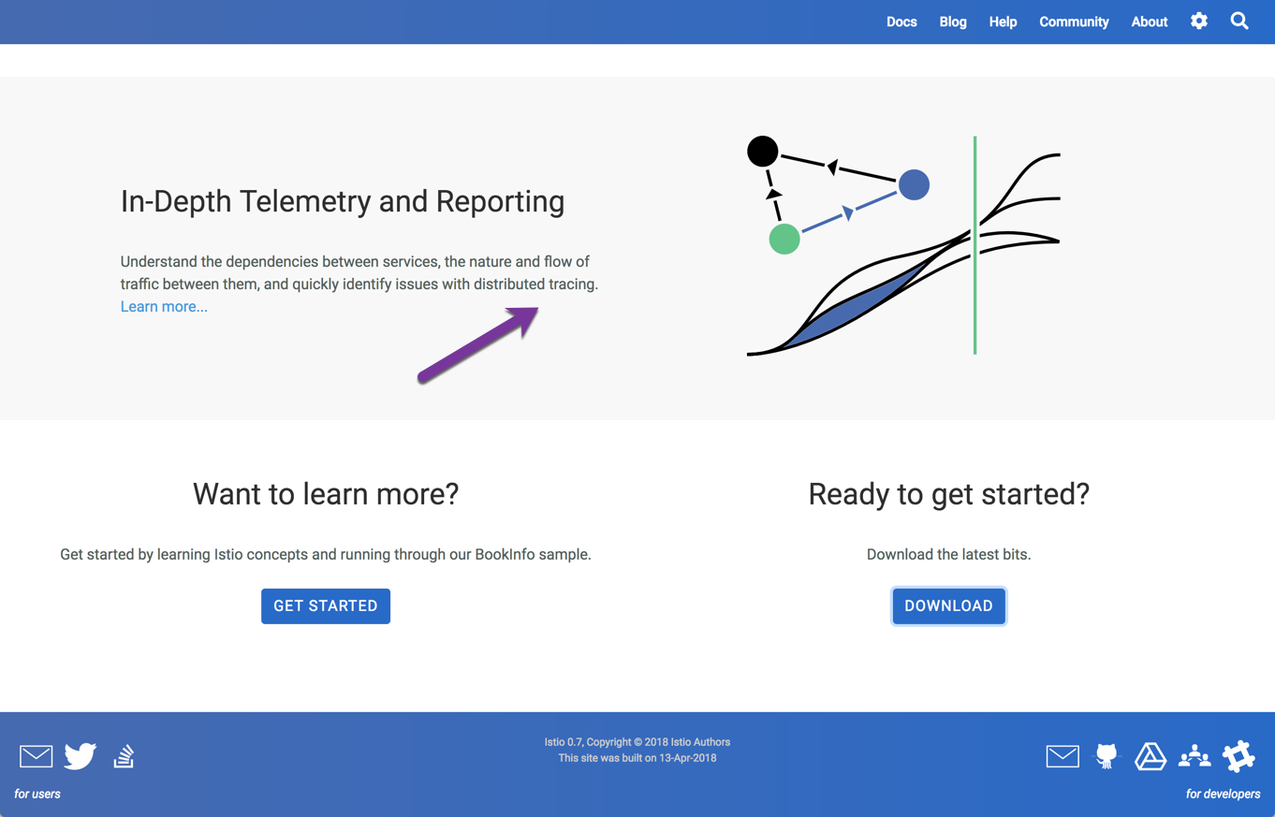
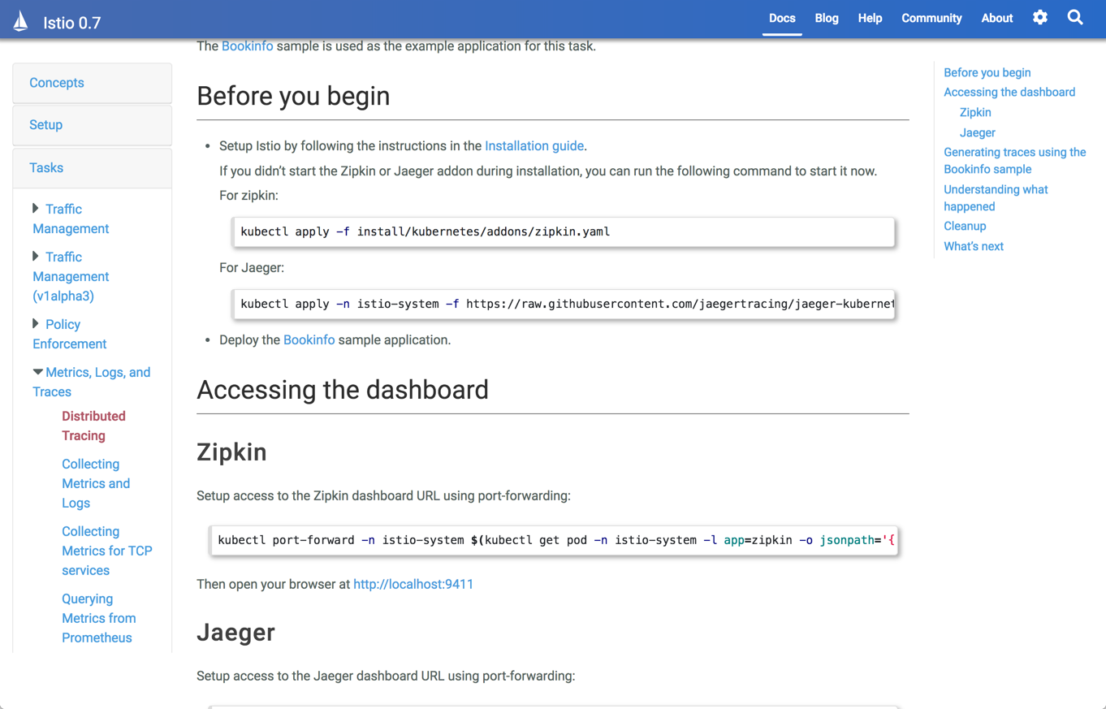
Zipkin – Use within Istio
Zipkin is a distributed tracing system.
At this time current plans are to use Zipkin within the Istio offering.

Slide 13
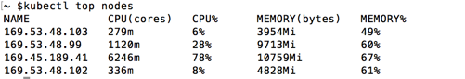
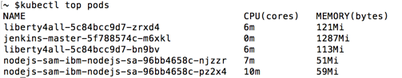
kubectl – view node and pods resources
Command line monitoring
View node resources
Command: kubectl top nodes
View pod resources
Command: kubectl top pods

Slide 14
Logging

Slide 15

Exposed logging in IBM Cloud Private
Private
Public
Y
N
IBM Cloud Private example diagram
Alerts
Extendable Dashboards and Alerts
(Kibana & Grafana)
Dashboard show the status and metrics for the workloads and environment.
Elastic Stack collects logs from all the nodes (e.g. Master, Worker) and workloads.
Prometheus collects metrics.
Kibana and Grafana dashboards provide visibility of collected data.
Prometheus can be configured to send alerts to external sources. Example sources are email and webhooks.
5
4
Default Dashboard
1
3
Kubernetes
2
Prometheuss
ELK Stack
Heapster
Host Infrastructure

Slide 16
Kubernetes logs
Location of log files: /var/logs
Daemon | Node / Func | Filename | Description
API server | master | apiserver.log | Log for API calls
Scheduler | master | k8s-scheduler.log | Log for scheduler information for any containers scheduling events
Controller Manager | master | controller-manager.log | Log for controller events and issues
Kubelet | worker | kubelet.log | Log for any issues happening in any container
<network> | network | kube-proxy.log | Log for any network information

Slide 17
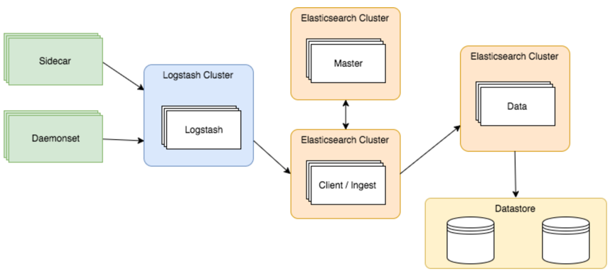
Elastic Stack is used
ELK stack is used to store collected logs.
Note: These services are deployed in the kube-system namespace.

Slide 18
Debugging

Slide 19
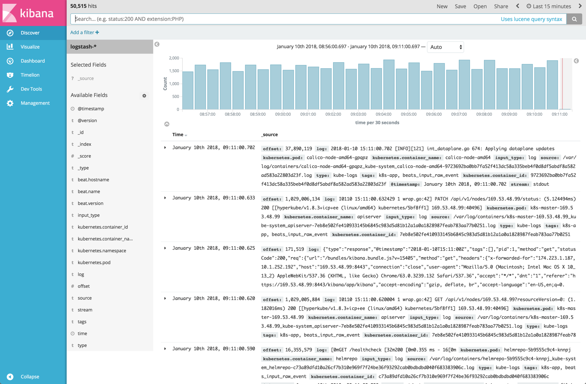
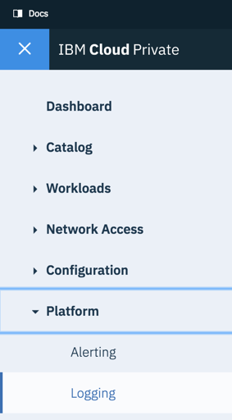
Kibana dashboard in IBM Cloud Private
From navigation menu select Platform / Logging
Viewing of collected logs from nodes and workloads.
Basic capabilities include:
Selection of time period
Selection of captured data
Search by value
Visualize over time
https://<Master node ip>:8443/kibana

Slide 20
kubectl – Viewing information
kubectl -n kube-system get pods -o wide | grep –v Running
kubectl -n kube-system describe pod/<pod_name> [any pod shown in an error state from above]
kubectl -n kube-system logs pod/<pod_name> [any pod shown in an error state from above]
--container <container_name> [once for each container within the pod]
# ubuntu logs for kubelet
journalctl -r -u kubelet

Slide 21
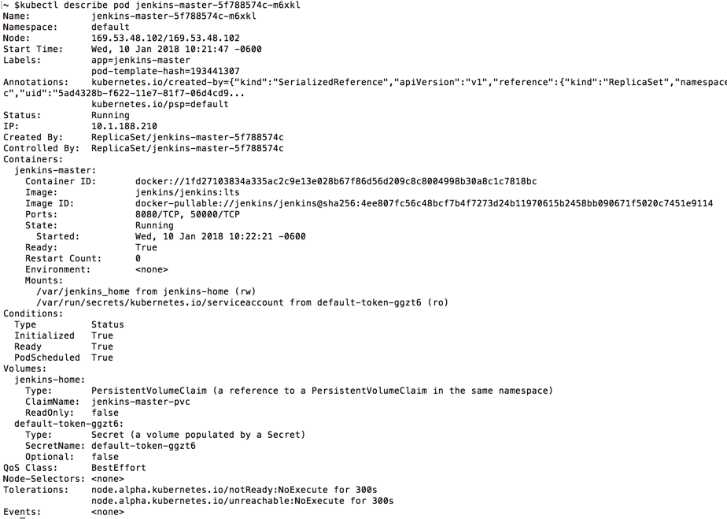
kubectl – view pod information
Command: kubectl describe pod <pod-name>

Slide 22
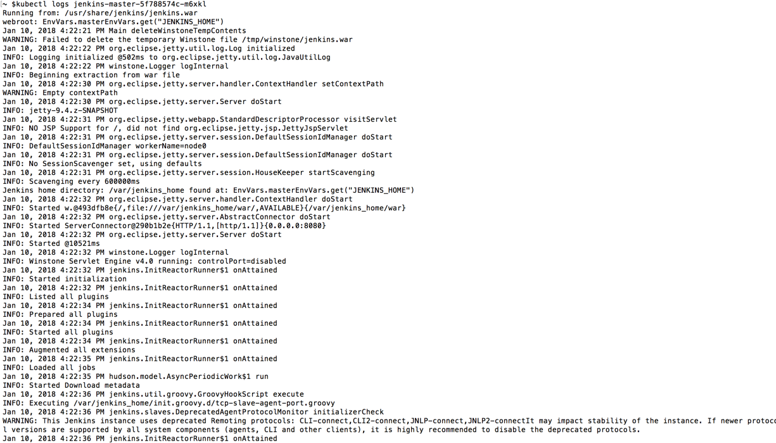
kubectl – view pod and container logs
Command: kubectl logs <pod-name> --container <container-name>

Slide 23
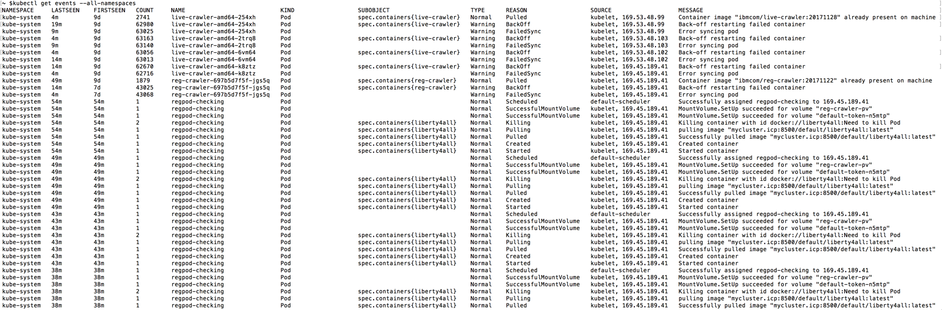
kubectl – view events
Command: kubectl get events -–all-namespaces

Slide 24
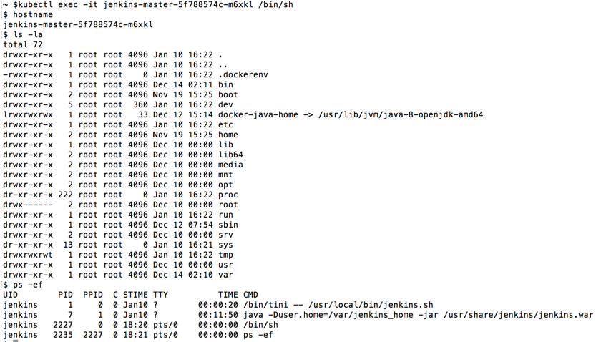
kubectl – exec command into running container
Command: kubectl exec -it <pod-name> /bin/sh

Slide 25
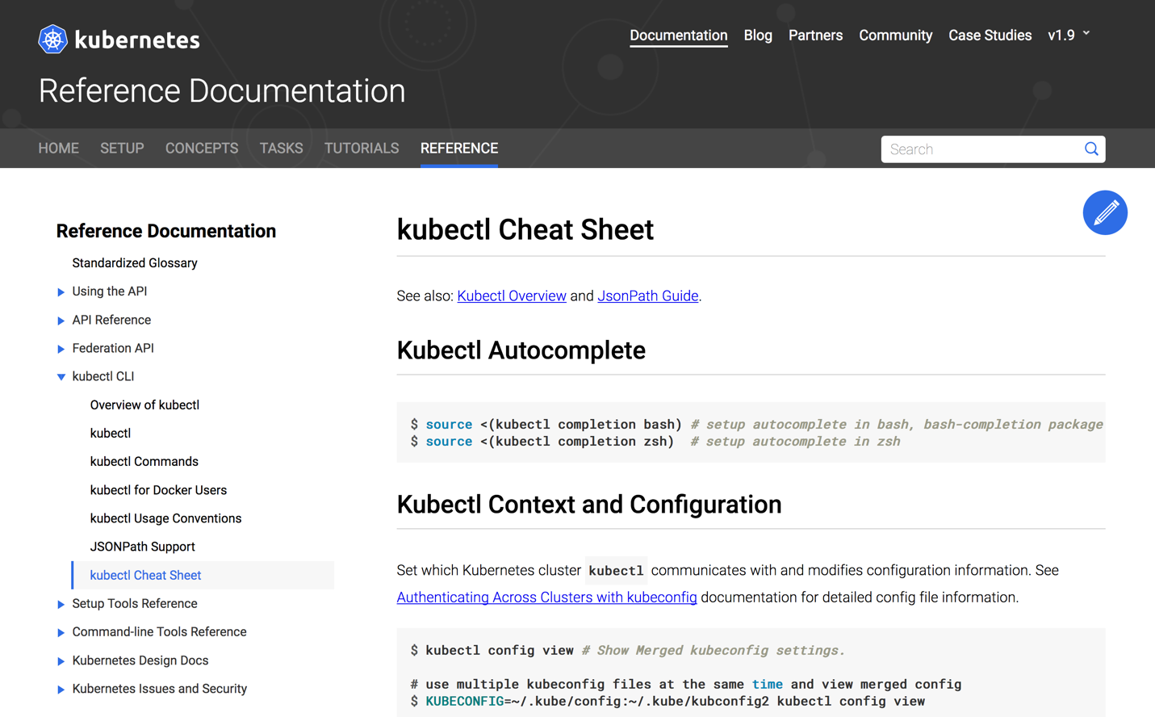
kubectl – Cheat Sheet
“kubectl” - is a command line interface for issuing commands to Kubernetes clusters.
https://kubernetes.io/docs/reference/kubectl/cheatsheet/

Slide 26
Command Line Interface (CLI) tools
bx – manage IBM Cloud Private with the use of ICP plugins (e.g. bx pr)
docker – used for interacting with docker
kubectl – used for running commands against Kubernetes clusters
calicoctl – primary tool for viewing, manipulating, and creating Calico objects
systemctl – systemd is an init system used in Linux distributions to bootstrap the user space and to manage system processes after booting
journalctl – is a system utility used for querying and displaying messages from the journal

Slide 27
top – Linux Process Monitoring vmstat – Virtual Memory Statistics lsof – List Open File tcpdump – Network Packet Analyzer netstat – Network Statistics htop – Linux Process Monitoring monitorix – Sys and Ntwk Monitoring
Command Line Interface (CLI) tools to monitor Linux
iotop – Monitor Linux Disk I/O iostat – Input / Output Statistics iptraf – Real Time IP LAN Monitoring psacct – Monitor User Activity monit – Linux Process & Srvc Monitoring
nethogs – Monitor Per Process Network
nmon – Monitor Linux Performance
https://www.tecmint.com/command-line-tools-to-monitor-linux-performance/

Slide 28
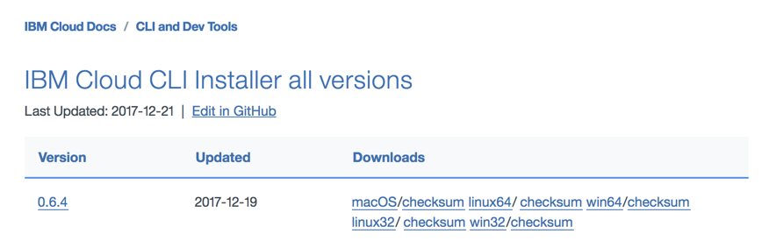
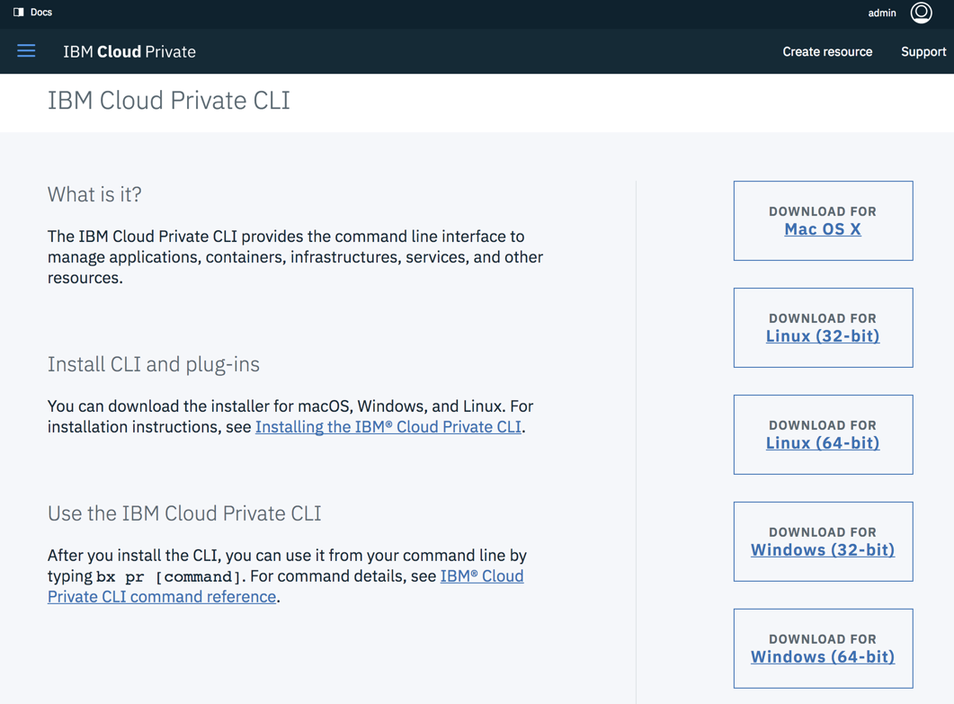
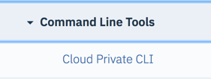
IBM Cloud CLI (bx) and IBM Cloud Private (pr) plugin
IBM Cloud CLI must be downloaded and installed.
Along with this CLI the IBM Cloud Private plugin must also be downloaded and installed.
https://console.bluemix.net/docs/cli/reference/bluemix_cli/all_versions.html#ibm-cloud-cli-installer-all-versions
IBM Cloud Private plugin
Cloud Private menu option
Download required plugin
Install downloaded plugin:
bx plugin install <filename>

Slide 29
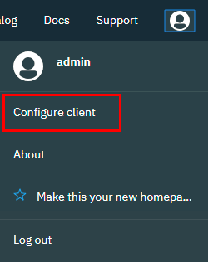
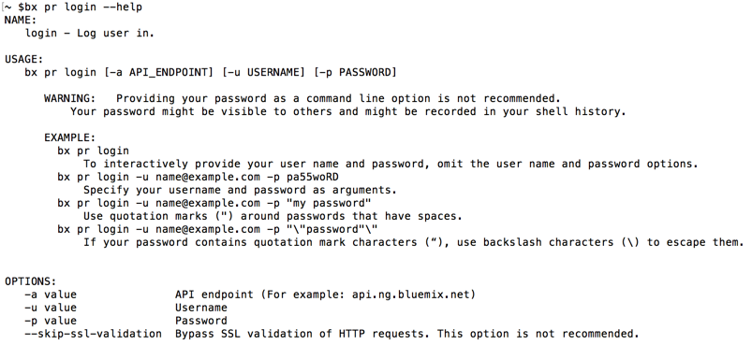
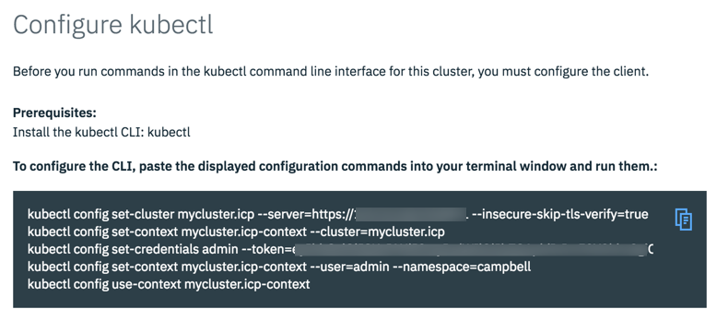
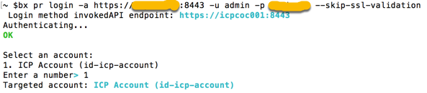
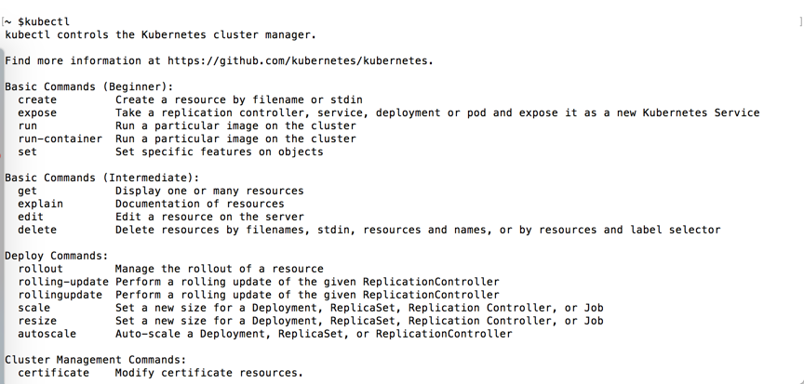
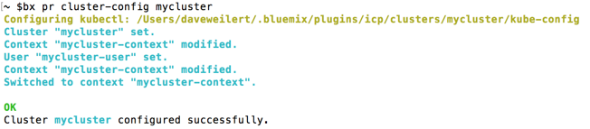
kubectl – authentication and context
Use of the kubectl CLI requires proper authentication and context. Two methods to accomplish this are using the ICP browser option ‘Configure client’ or the use of the ’bx pr login’.
ICP browser option ‘Configure client
bx pr login --help
bx pr login –a https://<icpserver>:8443 . . .
bx pr clusters
bx pr cluster-config <cluster-name>
https://www.ibm.com/support/knowledgecenter/en/SSBS6K_2.1.0/manage_cluster/cfc_cli.html

Slide 30
Resources for next steps

Slide 31

Resources for next steps
IBM Cloud Private Knowledge Center
https://www.ibm.com/support/knowledgecenter/en/SSBS6K_2.1.0.3/
Stack Overflow
https://stackoverflow.com/questions/tagged/ibm-cloud-private
Slack at IBM
https://ibm-cloud-tech.slack.com/ Over 35 ‘private-cloud’ channels available

Slide 32



Resources for next steps
Grafana Labs Getting Started
http://docs.grafana.org/guides/getting_started/
Kibana 5 Introduction YouTube videos
https://www.youtube.com/watch?v=mMhnGjp8oOI&t=437s
IBM developerWorks Recipes
https://developer.ibm.com/recipes/
Medium articles
https://medium.com/ibm-cloud

Slide 33



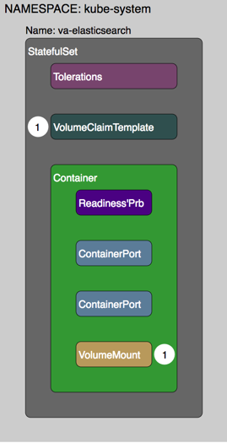
Resources for next steps
Kubernetes Documentation
https://kubernetes.io/docs/home
IBM Cloud Private - Center of Competency (CoC) provided assets
Instructions to deploy IBM Cloud Private CE in a single virtual machine.
https://github.ibm.com/gpacker/icp-ezsetup/blob/master/icp2101-singleVMsetupUbuntu.md
An easy to use and deploy app that helps test and understand Kubernetes
https://github.com/jconallen/kubetoy
Visual parsed Kubernetes (VpK) definitions
https://github.com/daveweilert/vpk

Slide 34
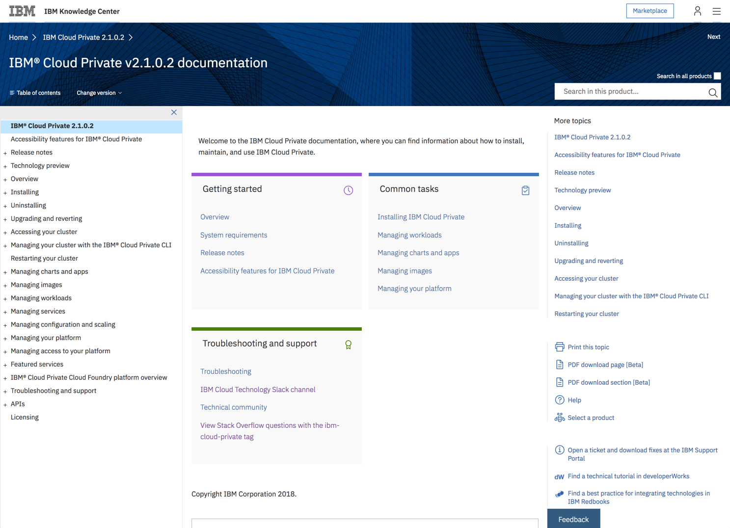
IBM Knowledge Center - Cloud Private
https://www.ibm.com/support/knowledgecenter/en/SSBS6K_2.1.0.2/

Slide 35
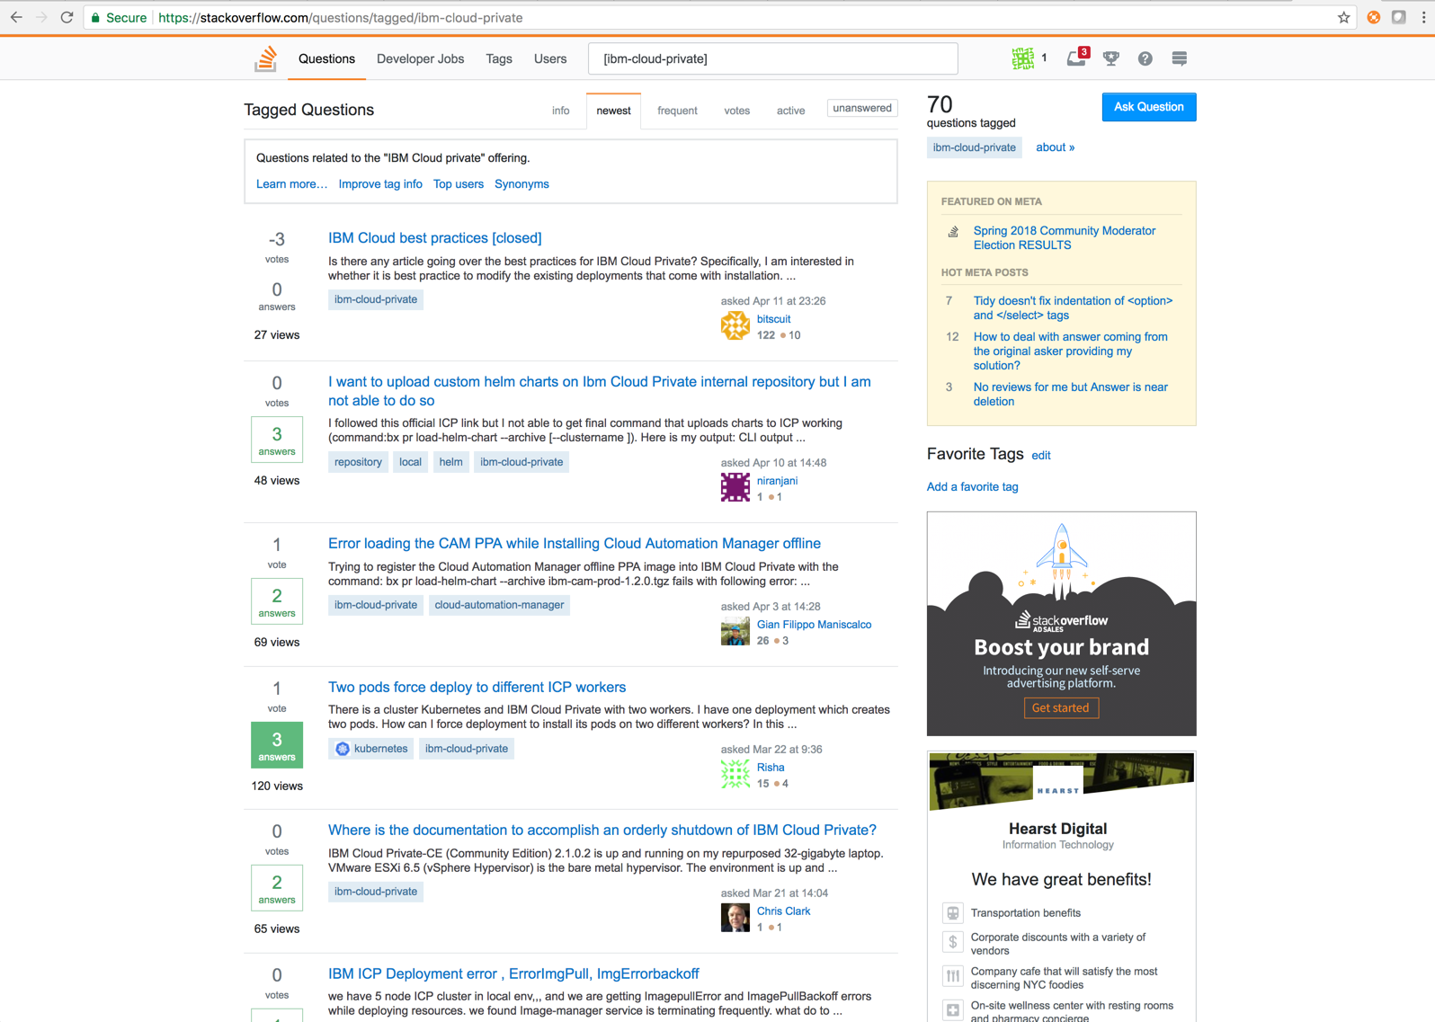
Stack Overflow
https://stackoverflow.com/questions/tagged/ibm-cloud-private

Slide 36
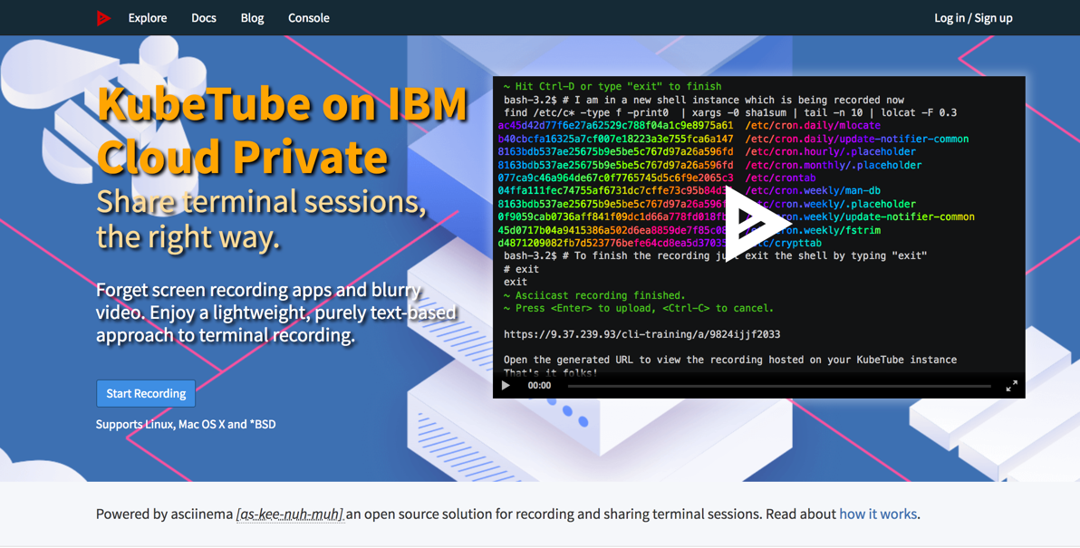
KubeTube
http://169.48.64.254:32321/

Slide 37
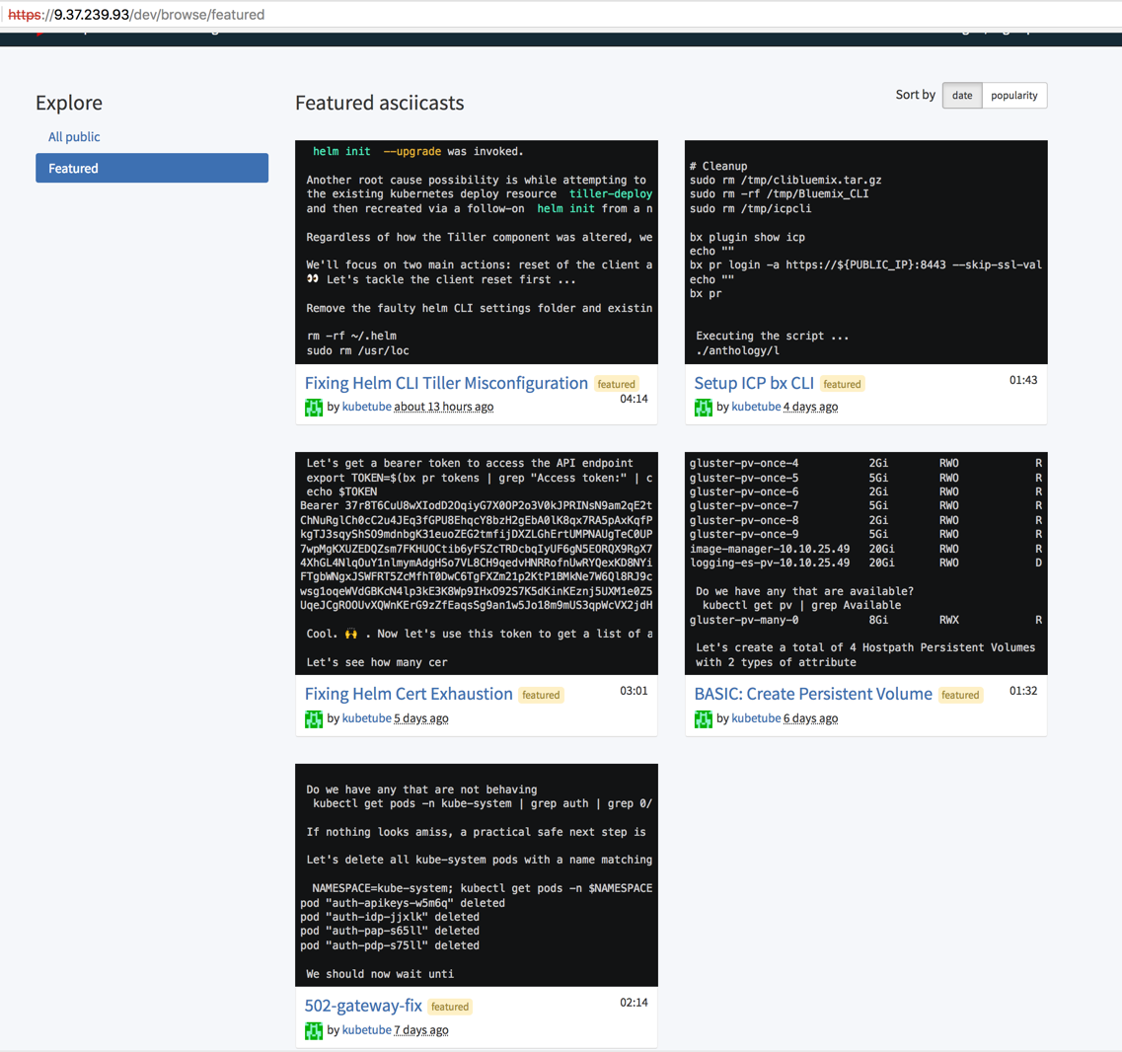
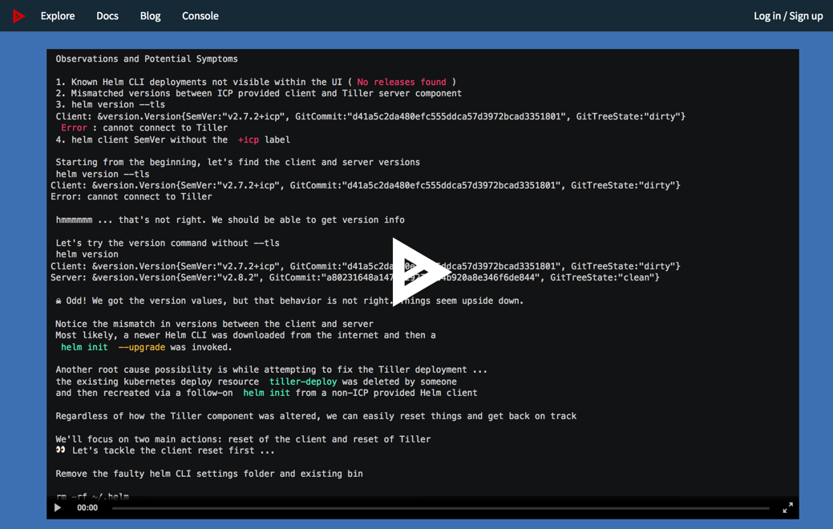
KubeTube – Featured asciicasts
Featured asciicasts
Fixing Helm CLI Tiller Misconfiguration
Setup ICP bx CLI
Fixing Helm Cert Exhaustion
BASIC: Create Persistent Volume
502-gateway-fix
http://169.48.64.254:32321/browse/featured

Slide 38
Grafana training
Several free or no-cost resources for Kibana training are available.
Grafana Labs Getting Started
http://docs.grafana.org/guides/getting_started/
Grafana Screencasts Episode 1 - Building Graphite Queries
https://youtu.be/mgcJPREl3CU
Grafana Screencasts Episode 2 - Templated Graphite Queries
https://youtu.be/FhNUrueWwOk
Grafana Screencasts Episode 7 - Beginners guide to building dashboards
https://youtu.be/sKNZMtoSHN4

Slide 39
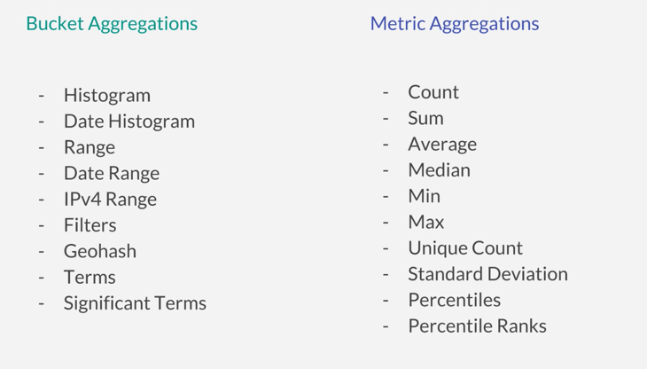
Kibana training
Several free or no-cost resources for Kibana training are available.
Kibana 5 Introduction
https://www.youtube.com/watch?v=mMhnGjp8oOI&t=437s
Visual transcript of above Kibana 5 Introduction video
https://www.timroes.de/2016/10/23/kibana5-introduction/
Kibana Aggregations Explained
https://www.youtube.com/watch?v=j-eCKDhj-Os&t=43s
Something as simple a understanding the categories and types of log aggregations can have a major impact in using Kibana visualizations.

Slide 40
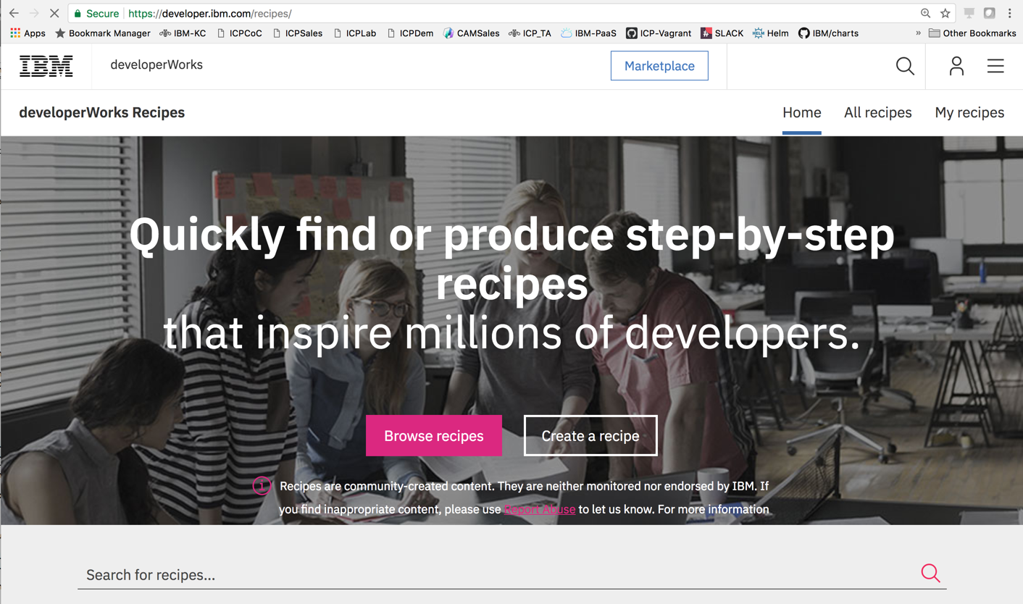
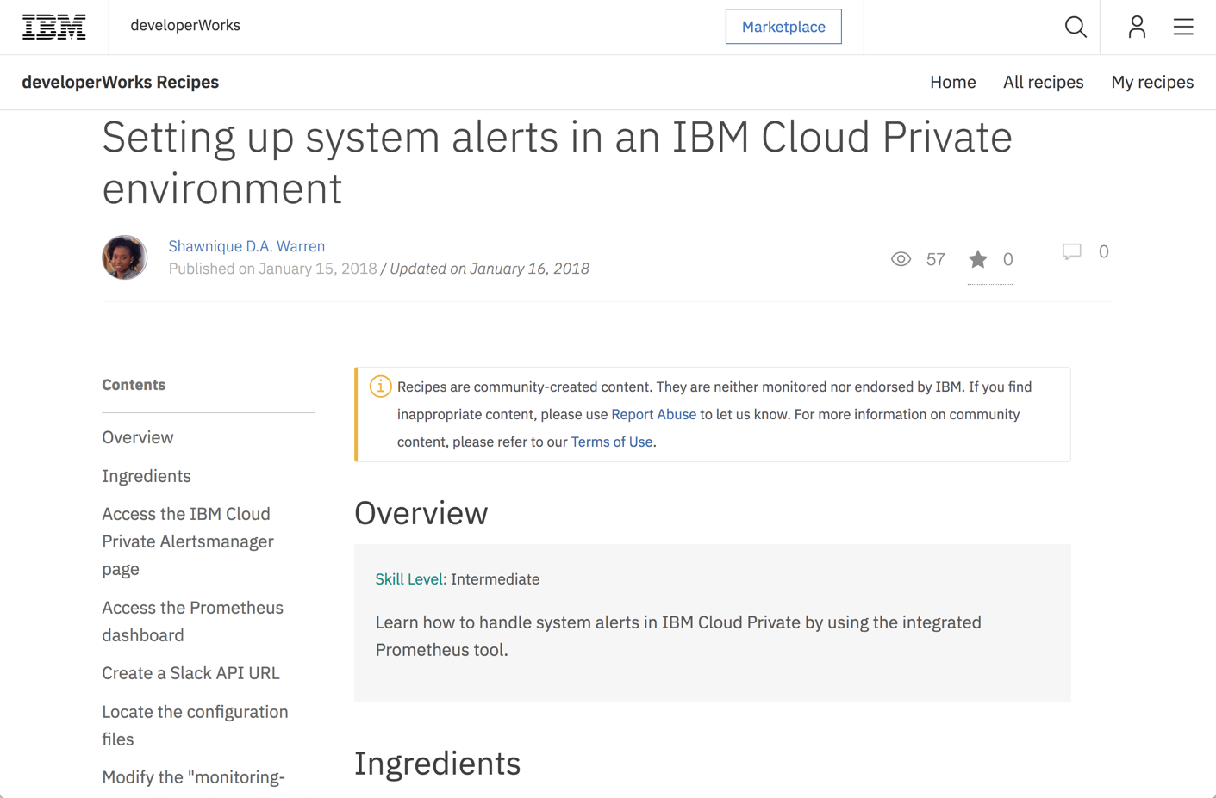
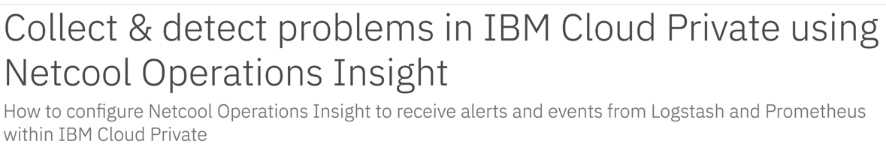
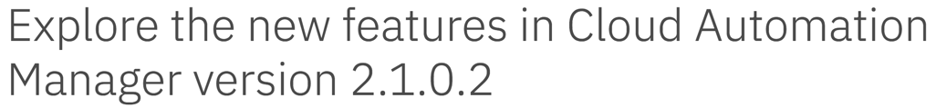
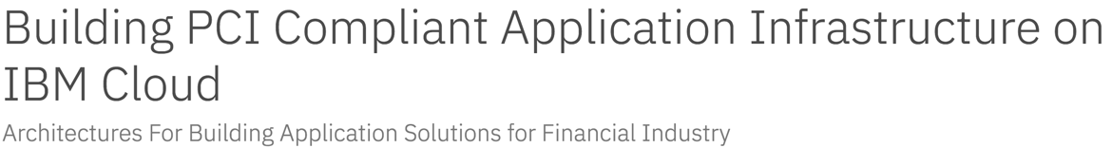
developerWorks Recipes
https://developer.ibm.com/recipes/
IBM developerWorks Recipes contains over 75 articles regarding IBM Cloud Private
https://developer.ibm.com/recipes/tutorials/setting-up-system-alerts-in-an-ibm-cloud-private-environment/

Slide 41
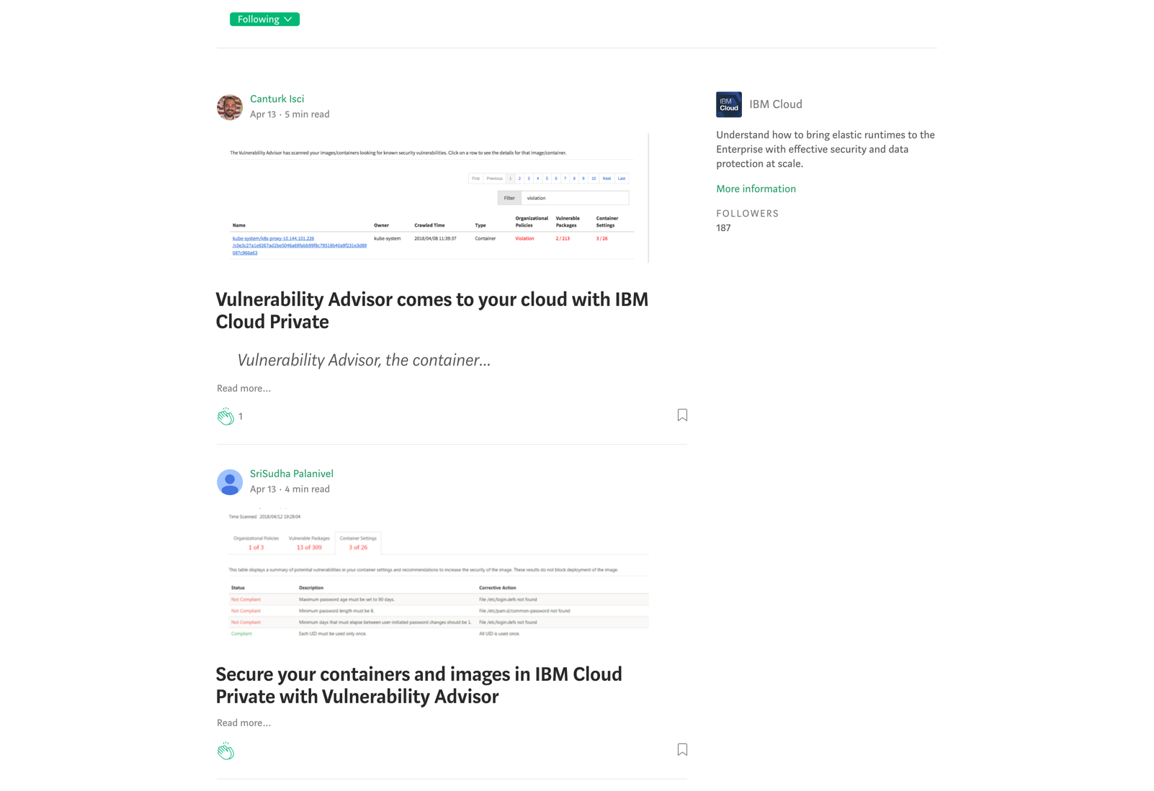
Medium articles
https://medium.com/ibm-cloud

Slide 42
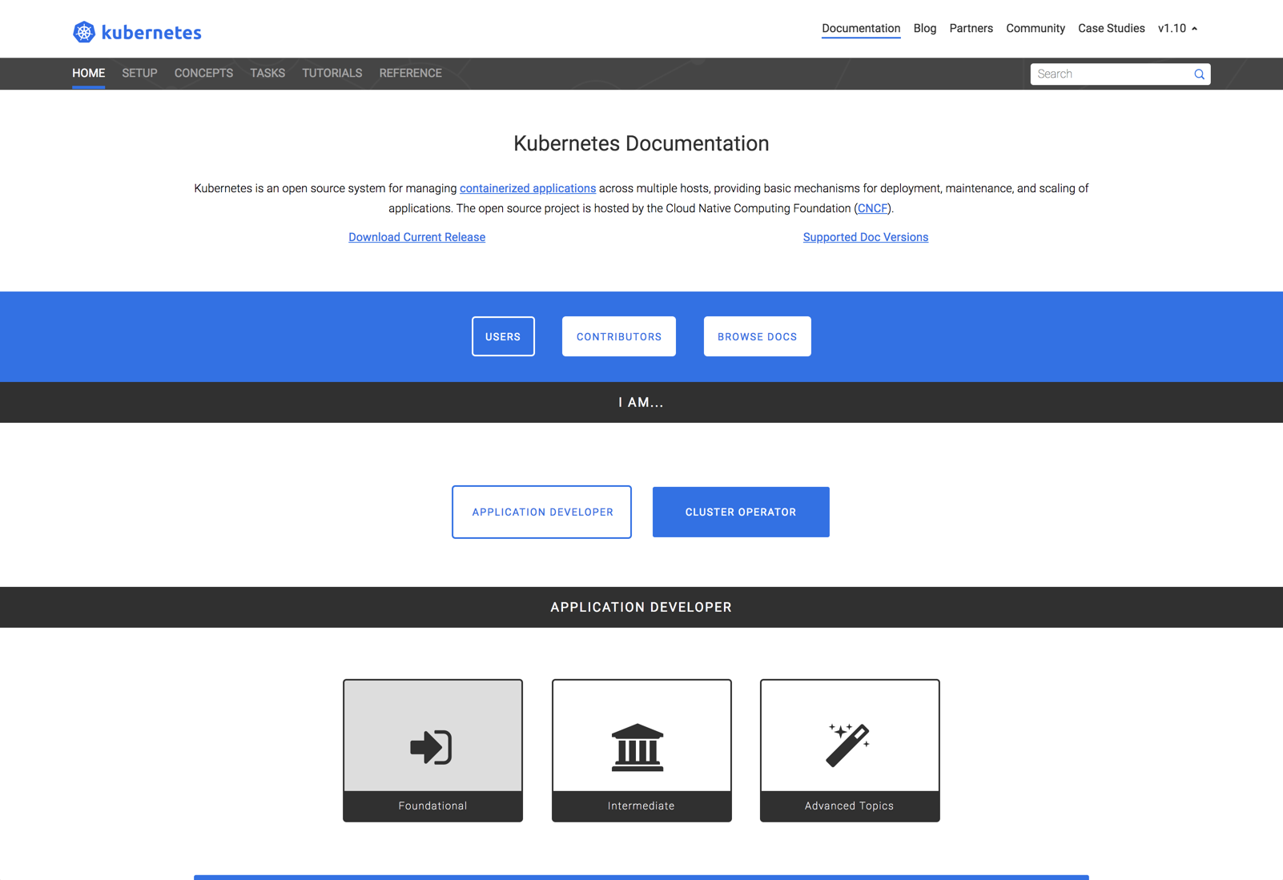
Kubernetes documentation
https://kubernetes.io/docs/home/?path=users&persona=app-developer&level=foundational

Slide 43
IBM Cloud Private Center of Competency (CoC) provided tools
Instructions to deploy IBM Cloud Private CE in a single virtual machine.
https://github.ibm.com/gpacker/icp-ezsetup/blob/master/icp2101-singleVMsetupUbuntu.md
An easy to use and deploy app to help test and understand Kubernetes
https://github.com/jconallen/kubetoy
Visual parsed Kubernetes (VpK) definitions
https://github.com/daveweilert/vpk

Slide 44
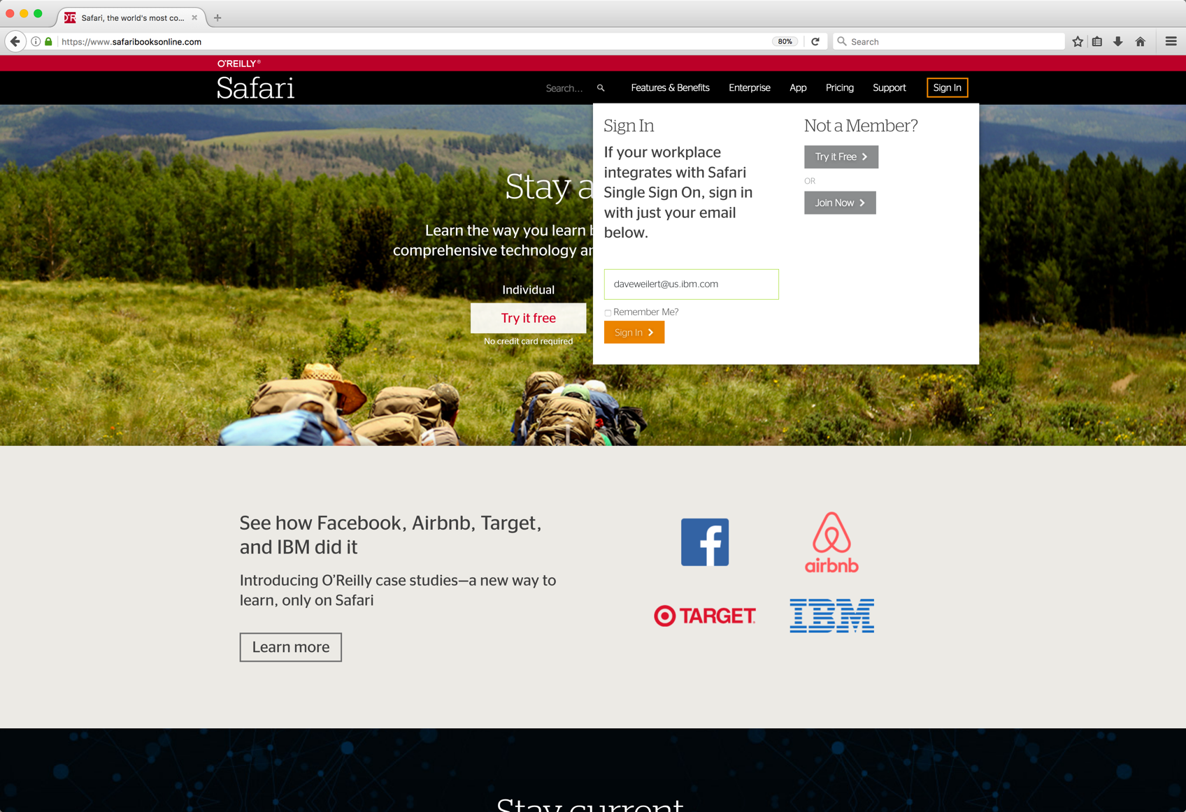
Safari Online Books
IBM employees are provided access to Safari Online Books.
Using your IBM email as your sign in will route authentication through the IBM authentication service.
https://www.safaribooksonline.com/

Slide 45
Questions?

Slide 46
Thank you

